Slide 1
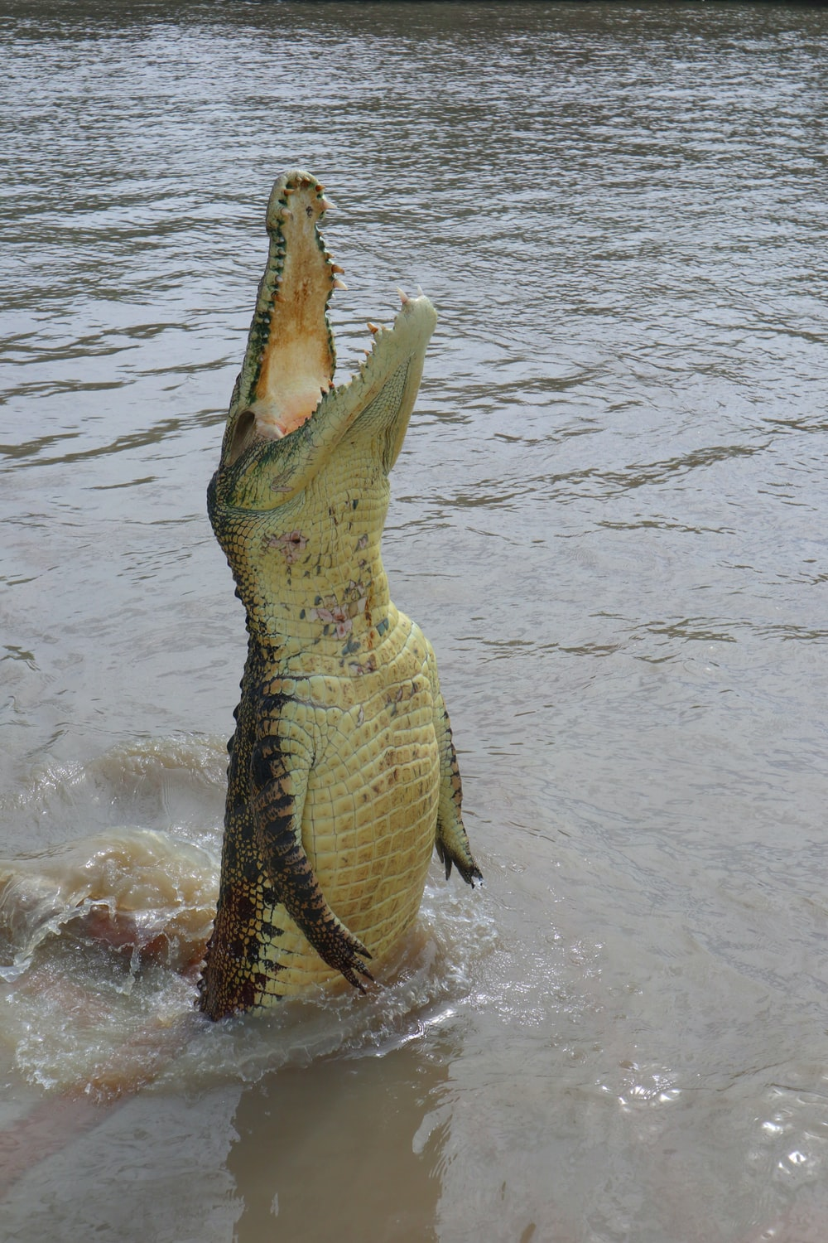

Modern statistics knowledge and skills: what you need and how to get it
Day 3 stats skills and
continue R Stats Bootcamp
Ed Harris
University of Mpumalanga, ZA
2023-03-23 to – 2023-03-30

Slide 2
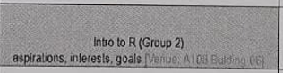
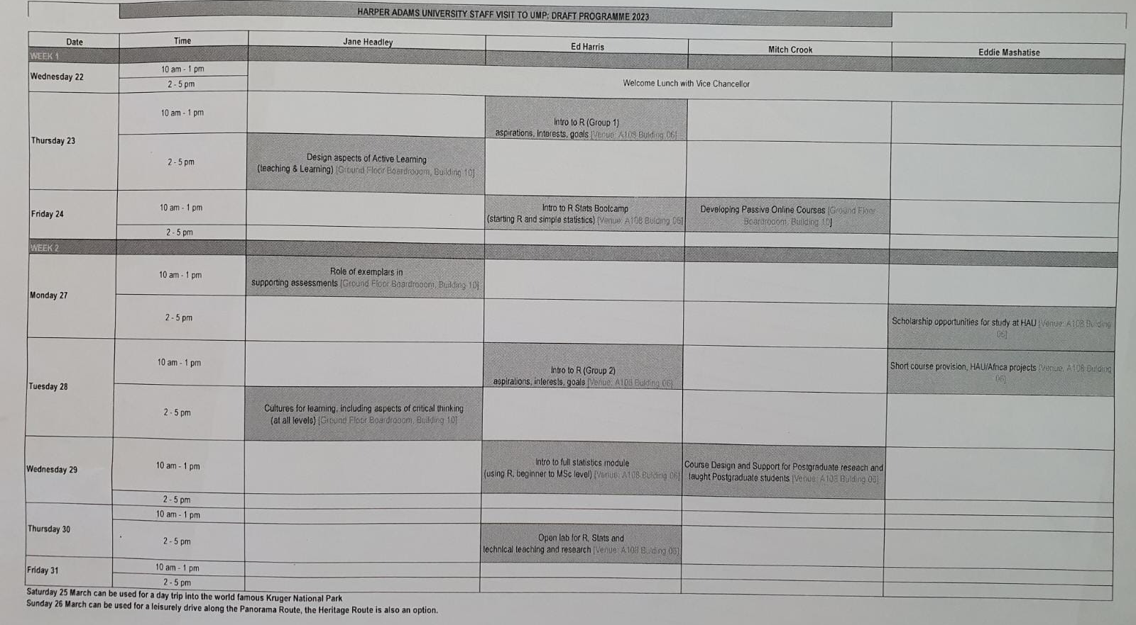


Slide 3
Last session
Continue R Stats Bootcamp
Basics, read in data
Questions and setup

Slide 4
Today
What stats skills do postgraduates and research need?
Continue R Stats Bootcamp (starting Module 2, pages 7, 9, 11…)
Data example…

Slide 5
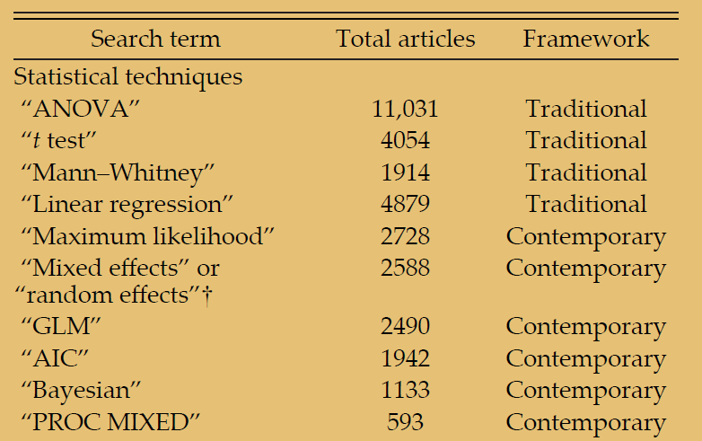
Stats techniques in papers (since 1990)
Touchon & McCoy 2016

Slide 6

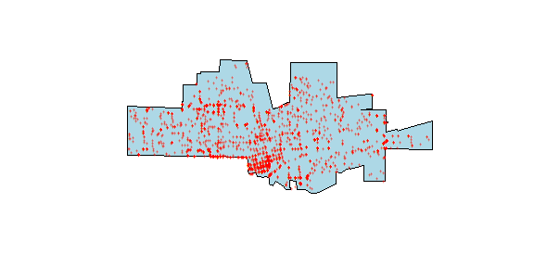


Use of mixed effects
Blocking
Repeated measures
Experimental replication
Spatial data
T1
T2
Group 1
Bess
Block 1
Block 2
Group 2
Sally
Group 3
Block 3
Block 4
Freya

Slide 7
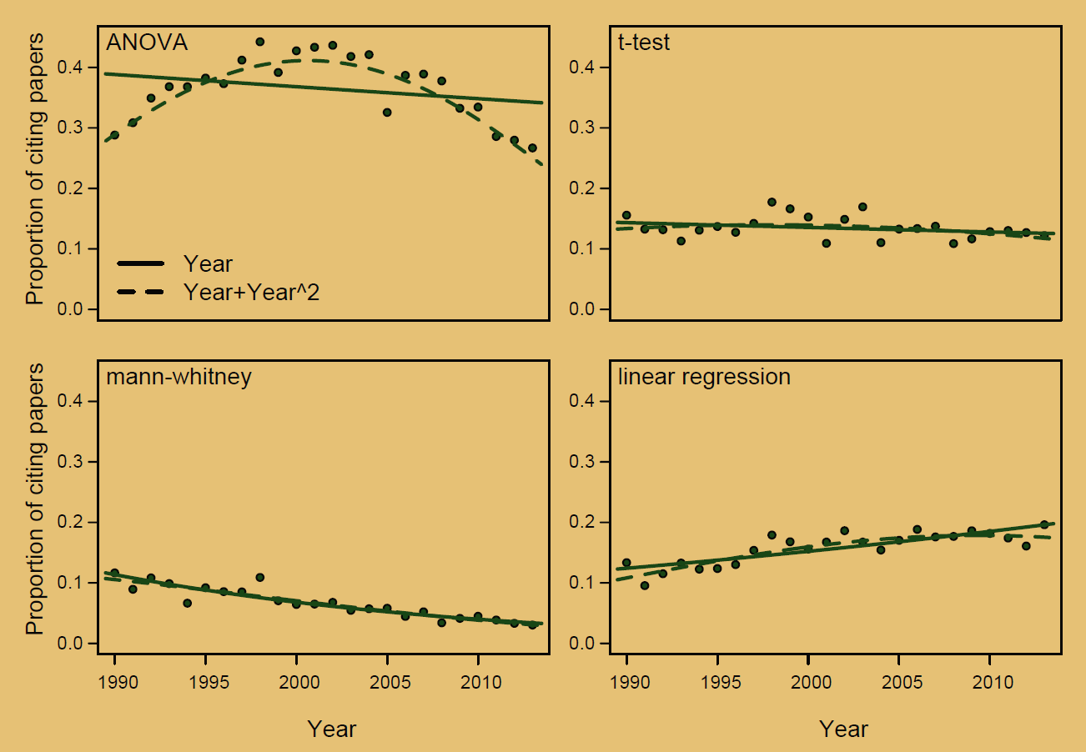
Stats techniques in papers (since 1990)
'Traditional'
techniques
Touchon & McCoy 2016

Slide 8
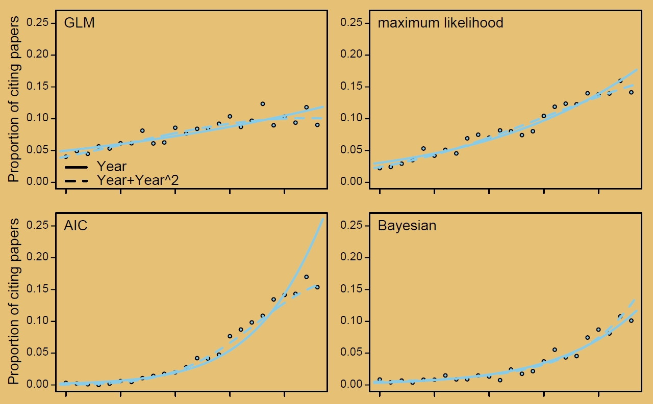
Stats techniques in papers (since 1990)
'Modern'
techniques
Touchon & McCoy 2016

Slide 9
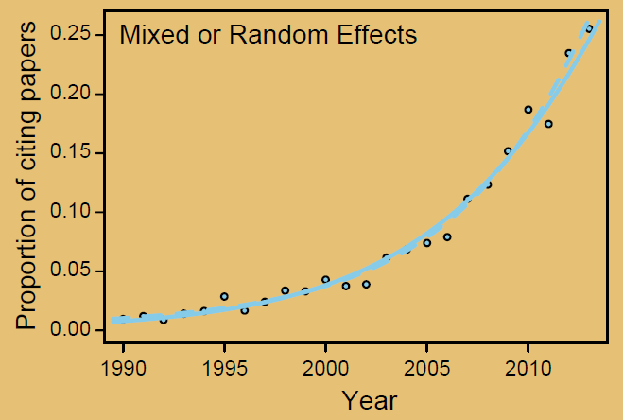
Stats techniques in papers (since 1990)
'Modern'
techniques
Touchon & McCoy 2016

Slide 10
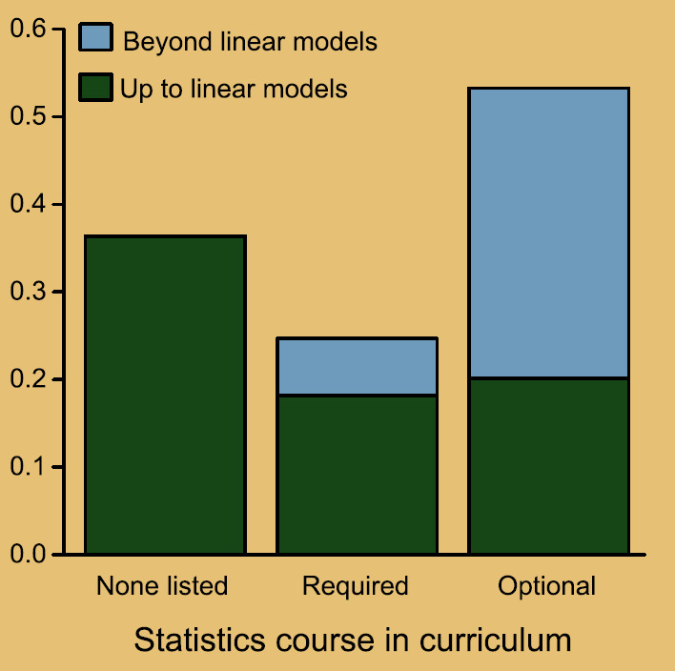
Training in research degrees
Touchon & McCoy 2016

Slide 11
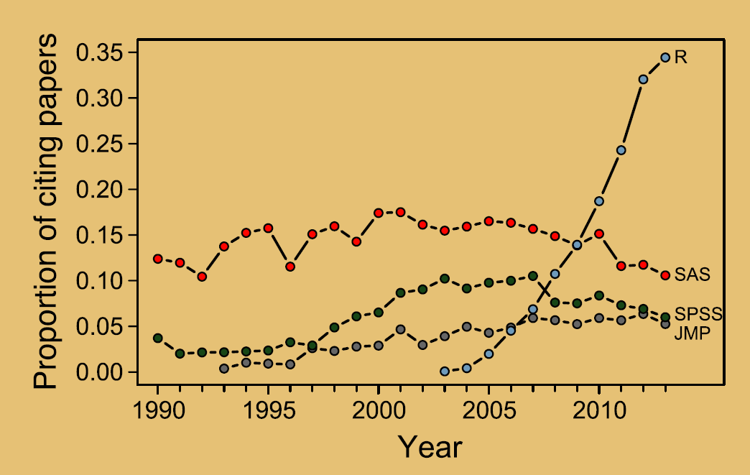
What stats software is cited in papers
Touchon & McCoy 2016

Slide 12
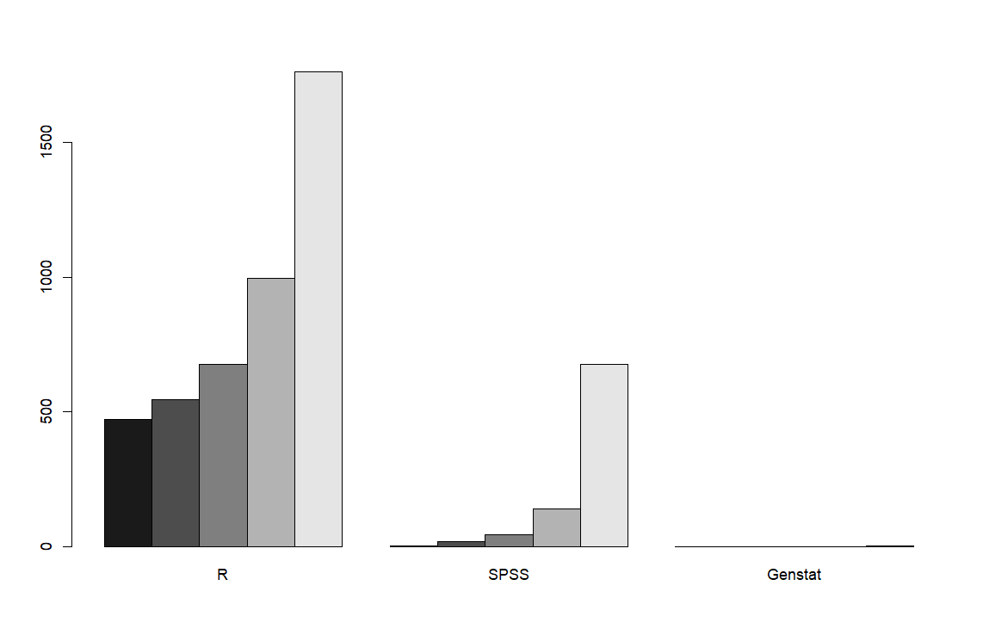
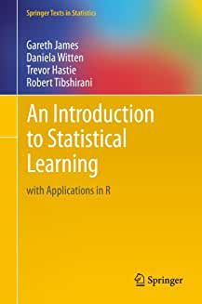
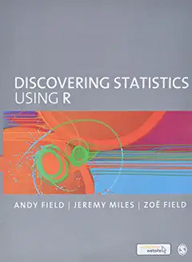
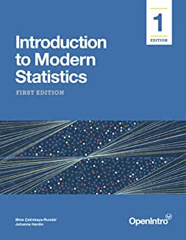
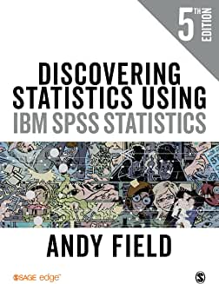
How 'popular' are stats packages?
Count of star-ranked reviews per
package on Amazon
(top 5, each package)

Slide 13
Skills in job advertisements
% Job
advertisements
(in ecology)
mentioning
data + stats + R
Auker & Barthelmess 2020

Slide 14
Models for acquiring stats and R skills
Easier
Engage with
or build a community
(E.g. HARUG!)
“PD”, take a class, short course, buy a book
Teach R + stats
R/stats practice with your students
Learn on-the-go with your own data

Slide 15
Models for acquiring stats and R skills
Challenge: Time
(we must incorporate our teaching, supervision and our own data practice into professional development)

Slide 16

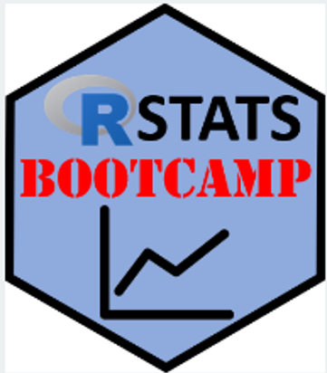



Stats teaching and learning resources (ubuntu, sharing)

Slide 17
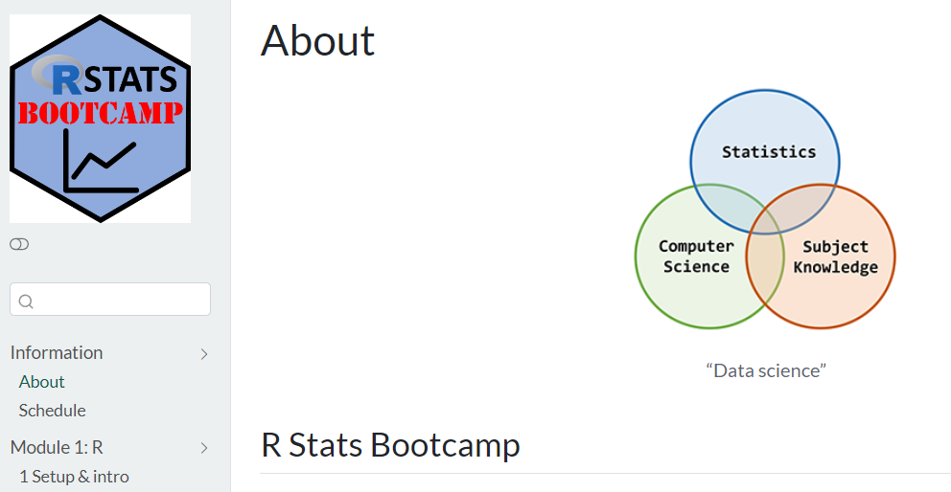
https://rstats-bootcamp.github.io/website/

Slide 18
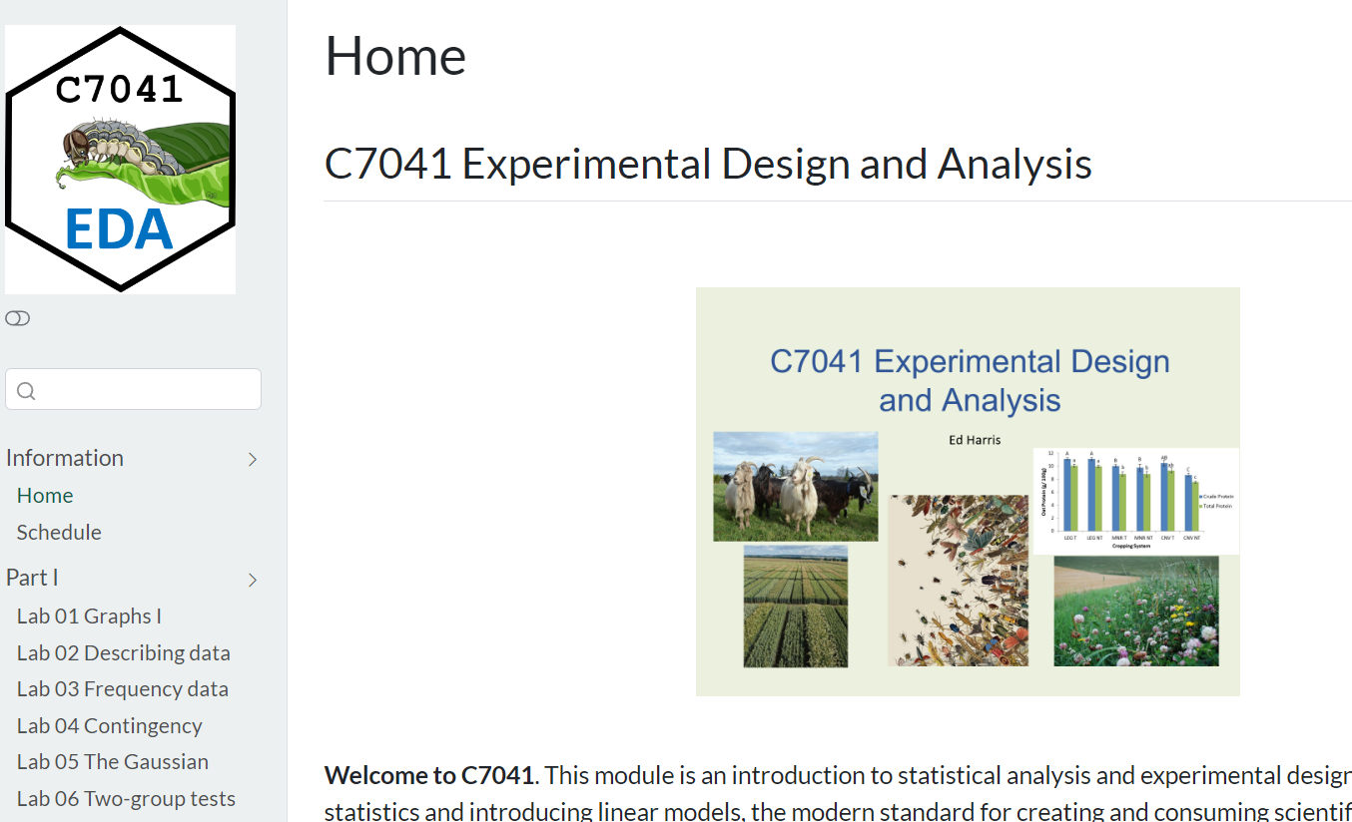
https://c7041-2022.github.io/website/

Slide 19
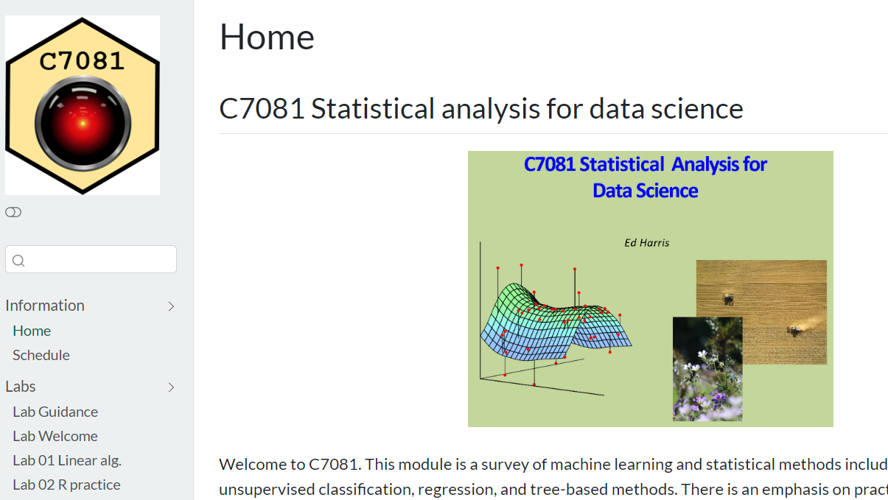
https://c7081-2022.github.io/website/

Slide 20
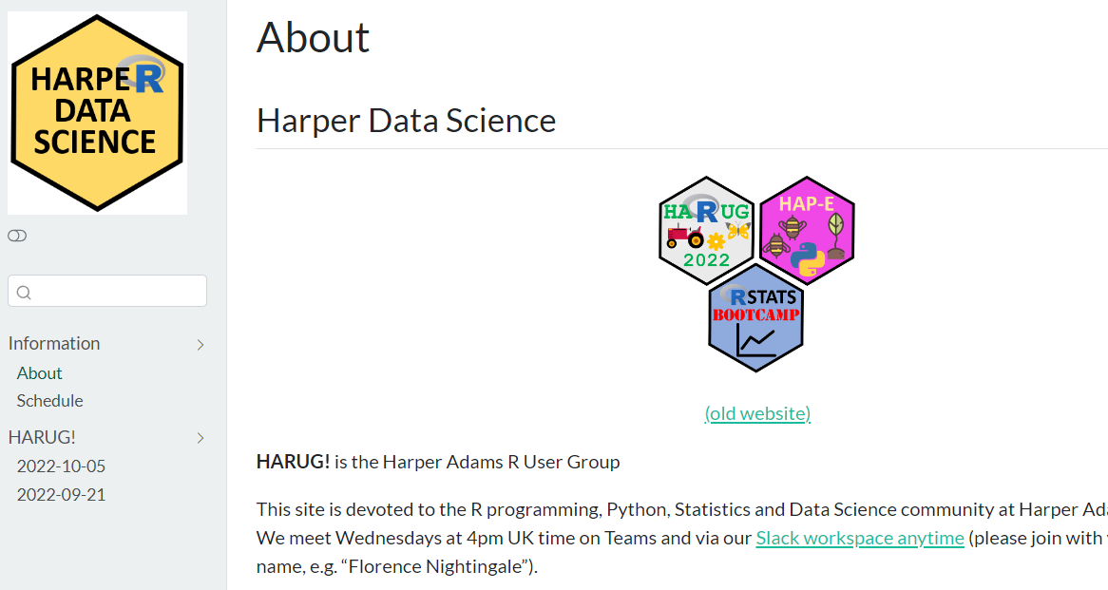
https://harper-data-science.github.io/website/

Slide 21
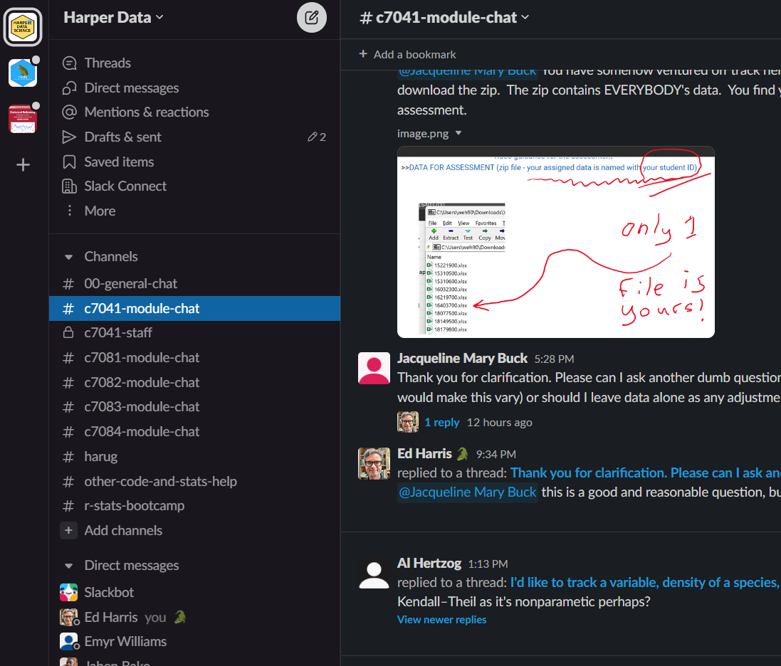
Slack community
https://tinyurl.com/2p8ejymb
Join with full name:
“Ed Harris”
And your preferred email
Founded Jan 2020
-1000s and 1000s of messages
-Harper research stats community
-(also teaching, data science)

Slide 22
https://rstats-bootcamp.github.io/website/

Slide 23

https://hauum-2023.github.io/website/
HAUUM = Harper Adams University – University of Mpumalanga

